Slide 1
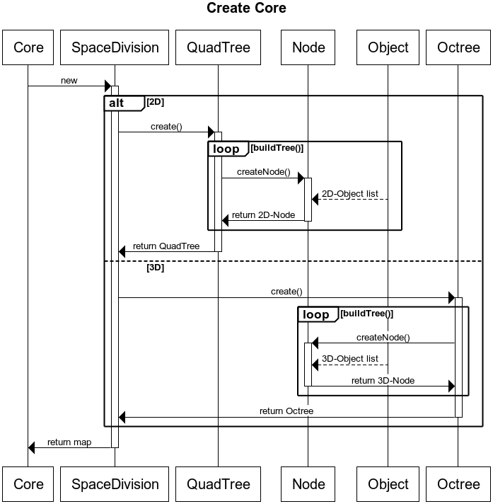
Create Core
title Create Core
Core->+SpaceDivision : new
alt 2D
SpaceDivision->+QuadTree : create()
loop buildTree()
QuadTree->+Node : createNode()
Object-->Node : 2D-Object list
Node->-QuadTree : return 2D-Node
end loop
QuadTree->-SpaceDivision : return QuadTree
else 3D
SpaceDivision->+Octree : create()
loop buildTree()
Octree->+Node : createNode()
Object-->Node : 3D-Object list
Node->-Octree : return 3D-Node
end loop
Octree->-SpaceDivision : return Octree
endSpaceDivision->-Core : return map

Slide 2
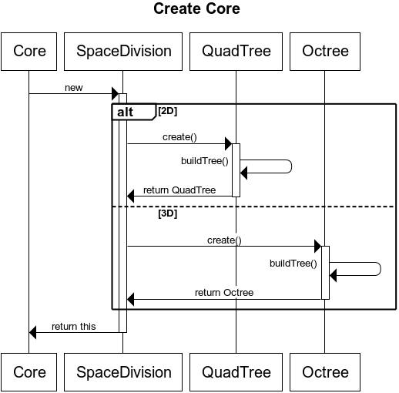
Create Core2
title Create Core
Core->+SpaceDivision : new
alt 2D
SpaceDivision->+QuadTree : create()
QuadTree->QuadTree : buildTree()
QuadTree->-SpaceDivision : return QuadTree
else 3D
SpaceDivision->+Octree : create()
Octree->Octree : buildTree()
Octree->-SpaceDivision : return Octree
End
SpaceDivision->-Core : return this

